Slide 1
Introduction to AI CT017-3-1 Ver 1.0
Basic Concepts of AI

Slide 2
Topic & Structure of The Lesson
AI problems
Development of AI
Areas of AI

Slide 3
Learning Outcomes
At the end of this topic, You should be able to
Basic Concepts of AI
AI Problems
Development of AI
Areas in Artificial Intelligence

Slide 4
Key Terms You Must Be Able To Use
If you have mastered this topic, you should be able to use the following terms correctly in your assignments and exams:
Artificial Intelligence
Human Intelligence
Turing Test
Chinese Room theory

Slide 5
Before we start
What come to your mind when the word AI is mention
I give you few minutes to type your answer on the chat so we could share.
Please don’t google and give me answer

Slide 6
My Question to you
Is terminator movie – AI?
Is transformer AI?
How about Robocop ?

Slide 7
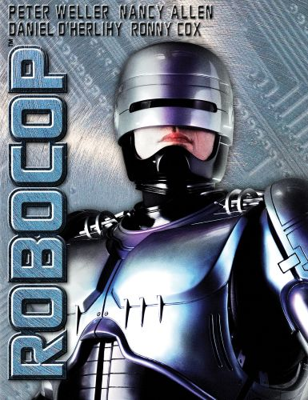
Lets meet how Robocop inspired
https://www.youtube.com/watch?v=K8YwiRBTp28
What’s your opinion guys – type in chat or someone wants to talk?

Slide 8
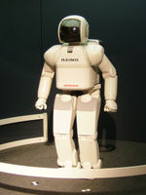
What is Artificial Intelligence?
Artificial Intelligence (AI) is a branch of computer science devoted to the study of computer hardware and software designed to imitate the thinking and reasoning powers of the human mind.

Slide 9
Other definitions
“…the science of making machines do things that would require intelligence if done by humans” - Marvin Minsky
“ …the part of computer science concerned with designing intelligent computer systems” - E.Feigenbaum

Slide 10
AI ultimate goal is to mimic human
AI
Expert Systems
Robotics
Natural Language Processing
Vision / Image processing
Neural network/machine learning

Slide 11
What is intelligence?
Are you intelligence?
Are animals intelligence ?
So what’s the definition of intelligence

Slide 12
What is intelligence?
Human intelligence?
Ability to learn or understand from experience
Ability to acquire and retain knowledge
Able to integrate experience and knowledge to solve problems
Ability to communication
Ability to be creative

Slide 13
Some areas on intelligence –not the whole video
https://www.youtube.com/watch?v=9NksDSX0Aeg

Slide 14
Implementing the goals of AI which are:
Systems that think like humans. | Systems that think rationally.
Systems that act like humans. | Systems that act rationally.

Slide 15
Thinking humanly
To get machine thinking like humans, the human minds need to be understood
Therefore, if the machine’s behaviour matches human behaviour, it can be concluded that some of the machine’s mechanisms may also be operating in human.

Slide 16
Acting humanly
Is based on Turing test i.e. ability to achieve human-level performance in all cognitive tasks shows intelligent behaviour
Note:
Additional exercise to be discussed during tutorial:
Explain Turing test

Slide 17
Thinking rationally
Related to logical thinking
Example:
We know Einstein is a man and all men are mortal; therefore we can conclude that Einstein is mortal

Slide 18
Acting rationally
Related to making correct inferences i.e. acting so as to achieve one’s goal, given one’s beliefs
Example:
We saw a nail in our path. We know that stepping on the nail will bring pain. Therefore, we use another path.

Slide 19
Tutorial 1 (What is Intelligence)
Why is it difficult to define "artificial intelligence"?
Why is it difficult to define "intelligence"?
List 6 aspects of human intelligence, and give an example of each

Slide 20
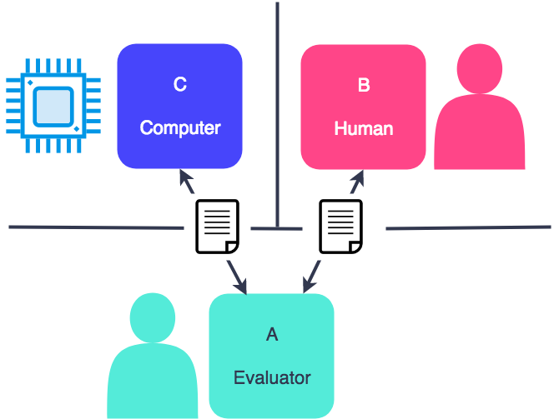
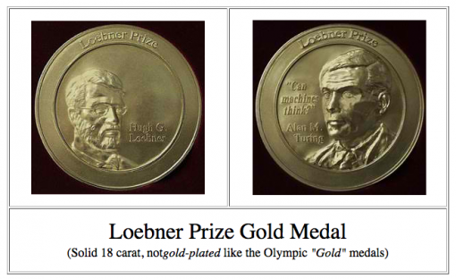
Turing Test
Alan Turing – father of Computer Science
https://www.youtube.com/watch?v=sXx-PpEBR7k

Slide 21
Tutorial on Turing Test
Describe the Turing Test in your own words.
If a computer program passed the Turing Test, could it be said to be "intelligent"? Give one argument in favour of this, and one against

Slide 22
Chinese Room Theory
Please watch this video
https://www.youtube.com/watch?v=TryOC83PH1g&t=2s
And if you still don’t understand watch below
https://www.youtube.com/watch?v=D0MD4sRHj1M&t=

Slide 23
Summary
In summary, the Chinese Room argument says that its is possible for a system to simulate intelligence without actually being intelligent. Whereas the Turing test is says that if a system can simulate intelligence then it actually is intelligent

Slide 24
Tutorial
In your own words – Explain Chinese Room Theory (5 marks)
Which application Does Chines Room theory come to your mind

Slide 25
Question and Answer Session
Q & A

